Slide 1


Pannagram
pan--genome:
annotations,
an-alysis &
diaagrams
Anna Igolkina
14.12.23

Slide 2
Pipeline for Multiple Genome Alignment
Two possibilities:
pangen_ref: align to one reference genome
pangen_consensus: align to several reference genomes, reference-free
Step 1. Genomes into chromosomes
Step 2. Chromosomes into parts
Step 3. BLAST of parts against the reference genome
Step 4. Alignment-1. Remaining syntenic (major) matches
Step 5. BLAST of gaps between syntenic matches
Step 6. Alignment-2. Fill the gaps between synteny blocks
Step 7. Combine reference-based alignments by chromosomes
Step 8. Randomisation of alignments. Combine two references: XXX and YYY
Step 9. Find Positions of Common Gaps in the Reference-Free Multiple Genome Alignment
Step 10. Prepare sequences for MAFFT
Step 11. Run MAFFT
Step 12. Combine all alignments together into the final one
Notes:
./pangen_ref.sh -pref_global ../pan_test/ly_th/ -ref_pref 0 -path_chr_ref ../pan_test/p27/chromosomes/ -n_chr_ref 5 -path_in ../lyrata/ -n_chr_query 8 -all_cmp T -cores 30

Slide 3
Pipeline for Multiple Genome Alignment
Two possibilities:
pangen_ref: align to one reference genome
pangen_consensus: align to several reference genomes, reference-free
Step 1. Genomes into chromosomes
Step 2. Chromosomes into parts
Step 3. BLAST of parts against the reference genome
Step 4. Alignment-1. Remaining syntenic (major) matches
Step 5. BLAST of gaps between syntenic matches
Step 6. Alignment-2. Fill the gaps between synteny blocks
Step 7. Combine reference-based alignments by chromosomes
Step 8. Randomisation of alignments. Combine two references: XXX and YYY
Step 9. Find Positions of Common Gaps in the Reference-Free Multiple Genome Alignment
Step 10. Prepare sequences for MAFFT
Step 11. Run MAFFT
Step 12. Combine all alignments together into the final one
Notes:
./pangen_ref.sh -pref_global ../pan_test/ly_th/ -ref_pref 0 -path_chr_ref ../pan_test/p27/chromosomes/ -n_chr_ref 5 -path_in ../lyrata/ -n_chr_query 8 -all_cmp T -cores 30

Slide 4
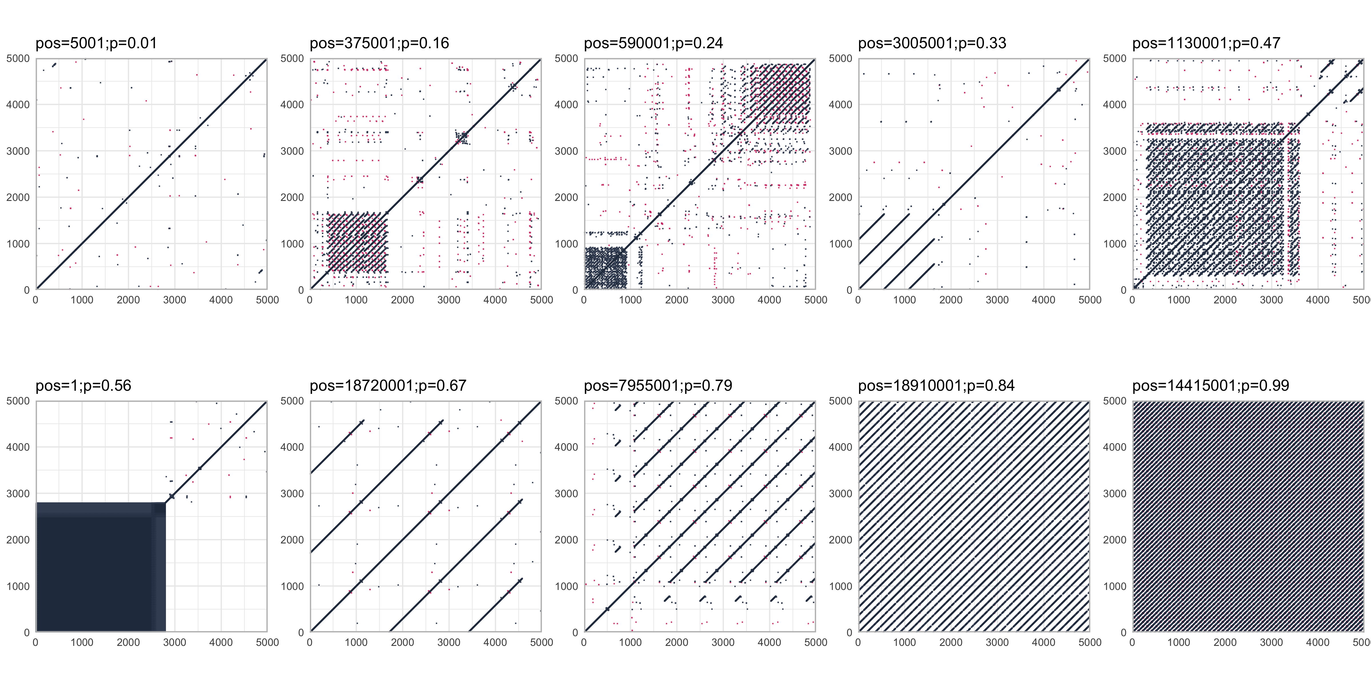
Complexity score
The proportion of k-mers that occur >= 3 times

Slide 5
Pipeline for Multiple Genome Alignment
Two possibilities:
pangen_ref: align to one reference genome
pangen_consensus: align to several reference genomes, reference-free
Step 1. Genomes into chromosomes
Step 2. Chromosomes into parts
Step 3. BLAST of parts against the reference genome
Step 4. Alignment-1. Remaining syntenic (major) matches
Step 5. BLAST of gaps between syntenic matches
Step 6. Alignment-2. Fill the gaps between synteny blocks
Step 7. Combine reference-based alignments by chromosomes
Step 8. Randomisation of alignments. Combine two references: XXX and YYY
Step 9. Find Positions of Common Gaps in the Reference-Free Multiple Genome Alignment
Step 10. Prepare sequences for MAFFT
Step 11. Run MAFFT
Step 12. Combine all alignments together into the final one
Notes:
./pangen_ref.sh -pref_global ../pan_test/ly_th/ -ref_pref 0 -path_chr_ref ../pan_test/p27/chromosomes/ -n_chr_ref 5 -path_in ../lyrata/ -n_chr_query 8 -all_cmp T -cores 30

Slide 6
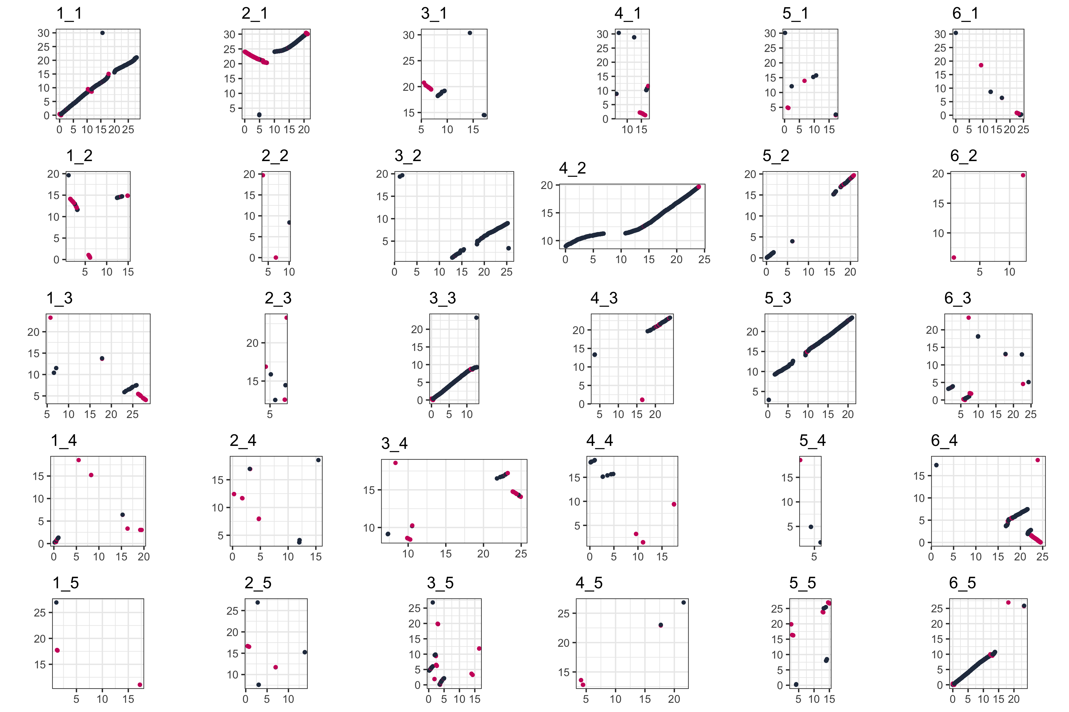
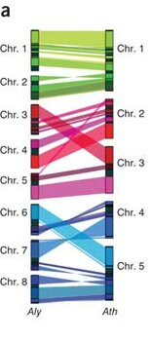
Major synteny
between query genome and one reference genome

Slide 7
Pipeline for Multiple Genome Alignment
Two possibilities:
pangen_ref: align to one reference genome
pangen_consensus: align to several reference genomes, reference-free
Step 1. Genomes into chromosomes
Step 2. Chromosomes into parts
Step 3. BLAST of parts against the reference genome
Step 4. Alignment-1. Remaining syntenic (major) matches
Step 5. BLAST of gaps between syntenic matches
Step 6. Alignment-2. Fill the gaps between synteny blocks
Step 7. Combine reference-based alignments by chromosomes
Step 8. Randomisation of alignments. Combine two references: XXX and YYY
Step 9. Find Positions of Common Gaps in the Reference-Free Multiple Genome Alignment
Step 10. Prepare sequences for MAFFT
Step 11. Run MAFFT
Step 12. Combine all alignments together into the final one
Notes:
./pangen_ref.sh -pref_global ../pan_test/ly_th/ -ref_pref 0 -path_chr_ref ../pan_test/p27/chromosomes/ -n_chr_ref 5 -path_in ../lyrata/ -n_chr_query 8 -all_cmp T -cores 30

Slide 8
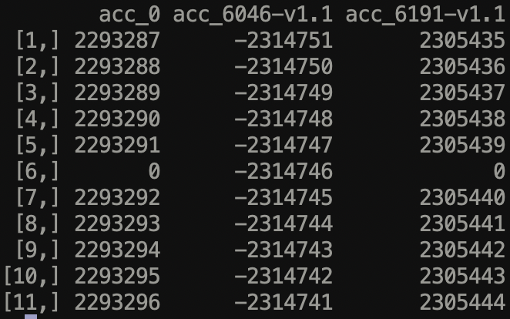
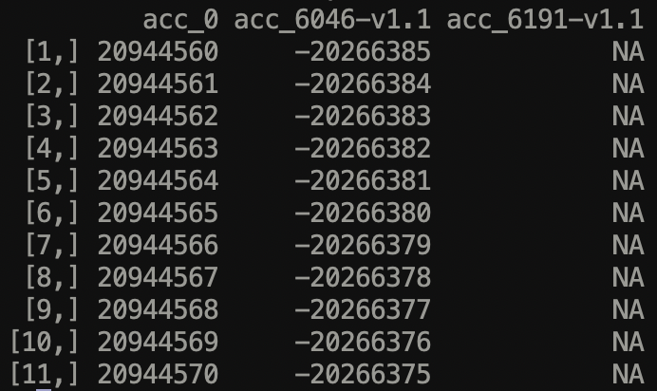
analys.sh –blocks
Get synteny blocks.
Also inserts NAs fot those positions which were not aligned

Slide 9
Correspondence between accessions
Chromosome 4
Chromosome 5

Slide 10
analys.sh -seq
Consensus sequence, and distribution of ACGT- per each pangenome position
-snp (in progress)

Slide 11
SV
sv.sh
-gff : annotation in pangenome coordinates and separate accessions
-te -te_file : similarity to a set of sequence
-graph : construction the graph of nestedness

Slide 12
Graph of Nestedness + Enrichment analysis
(in progress)

Slide 13
Visualisation
MGA=Multiple Genome Alignment

Slide 14
Graph of Nestedness: Enrichment
XXX

Slide 15
Search of copies of sequences in the Genomes
with a specific similarity threshold
./sim_search.sh -h
Usage: sim_search.sh [-h] [-in FASTA_FILE] [-genome GENOME_FILE] [-out OUTPUT_FILE] [-sim SIMILARITY_THRESHOLD] [-afterblast] [-keepblast]
This script performs a BLAST search on a given FASTA file against a specified genome and processes the results based on similarity thresholds.
-h, --help Display this help and exit.
-in FASTA_FILE Specify the input FASTA file.
-out OUTPUT_FILE Specify the output file for results.
-genome GENOME_FILE Specify the genome file to create BLAST database.
-sim SIMILARITY_THRESHOLD
Set the similarity threshold for BLAST (default: 85).
-afterblast Use this flag to process existing BLAST results.
-keepblast Use this flag to keep the BLAST temporary files.
Examples:
sim_search.sh -in input.fasta -genome genome.fasta -out out_85.txt
sim_search.sh -in input.fasta -genome genome.fasta -out out.txt -sim 90 -keepblast
mv out.txt out_90.txt
sim_search.sh -in input.fasta -genome genome.fasta -out out.txt -sim 95 -afterblast
mv out.txt out_95.txt

Slide 16
Gff to seq
XXX

Slide 17
Visualisation
dotplot
MSA

